Slide 1
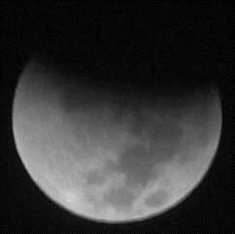
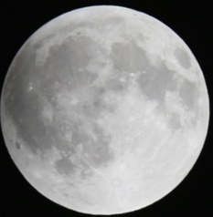
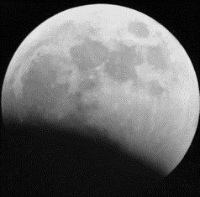
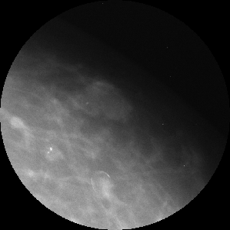
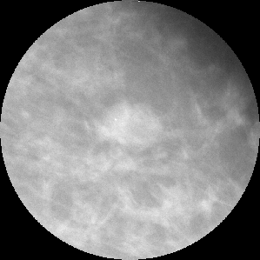
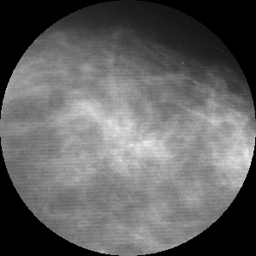
CNN for mammography: benign vs. malignant
Jeff Xing
CS6501
Which set is malignant?

Slide 2
Breast cancer statistics
Breast cancer
22.9% of diagnosed cancers
13.7% of cancer related to death worldwide
1 in 8 women develop invasive breast cancer in her lifetime
Current standard:
Routine mammography as preventive care ($100 vs $2000 MRI)
age 40 to 44 by personal choice
age 45 to 54 every year
age 55+ every 2 years
Balance against false positives
unnecessary invasive biopsy
unnecessary psychological/emotional harm

Slide 3
Breast Imaging Reporting and Data System
BI-RADS category 0, not enough information yet to complete the process (e.g. need ultrasound to confirm birads 2)
BI-RADS category 1, nothing notable and/or no change from prev exam
BI-RADS category 2, definitive benign finding
BI-RADS category 3, very low positive predictive value (less than 2%),
discouraged from being used (due to unnecessary worry/anxiety)
BI-RADS category 4, PPV of ~30%
subcategory 4A, PPV 13%
subcategory 4B, PPV 36%
subcategory 4C, PPV 79%
BI-RADS category 5, PPV of 95%
BI-RADS category 6, is for known cancer (often code used during follow-up)

Slide 4
How well can we predict malignancy without resorting to a biopsy?

Slide 5
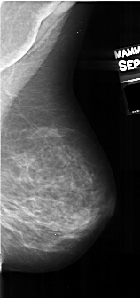
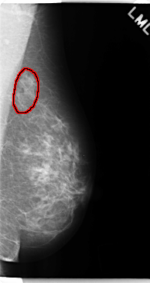
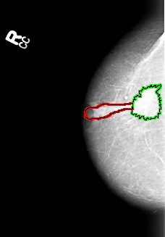
Dataset: Digital Database for Screening Mammography
Pathology (biopsy) confirmed benign or malignant status as gold standard truth labels
High resolution radiographic image + expert Radiologist annotated region boundary
Volume: normal_01
Case: A-0152-1
Volume: benign_01 Case: C-0241-1
Volume: cancer_01 Case: B-3013-1

Slide 6
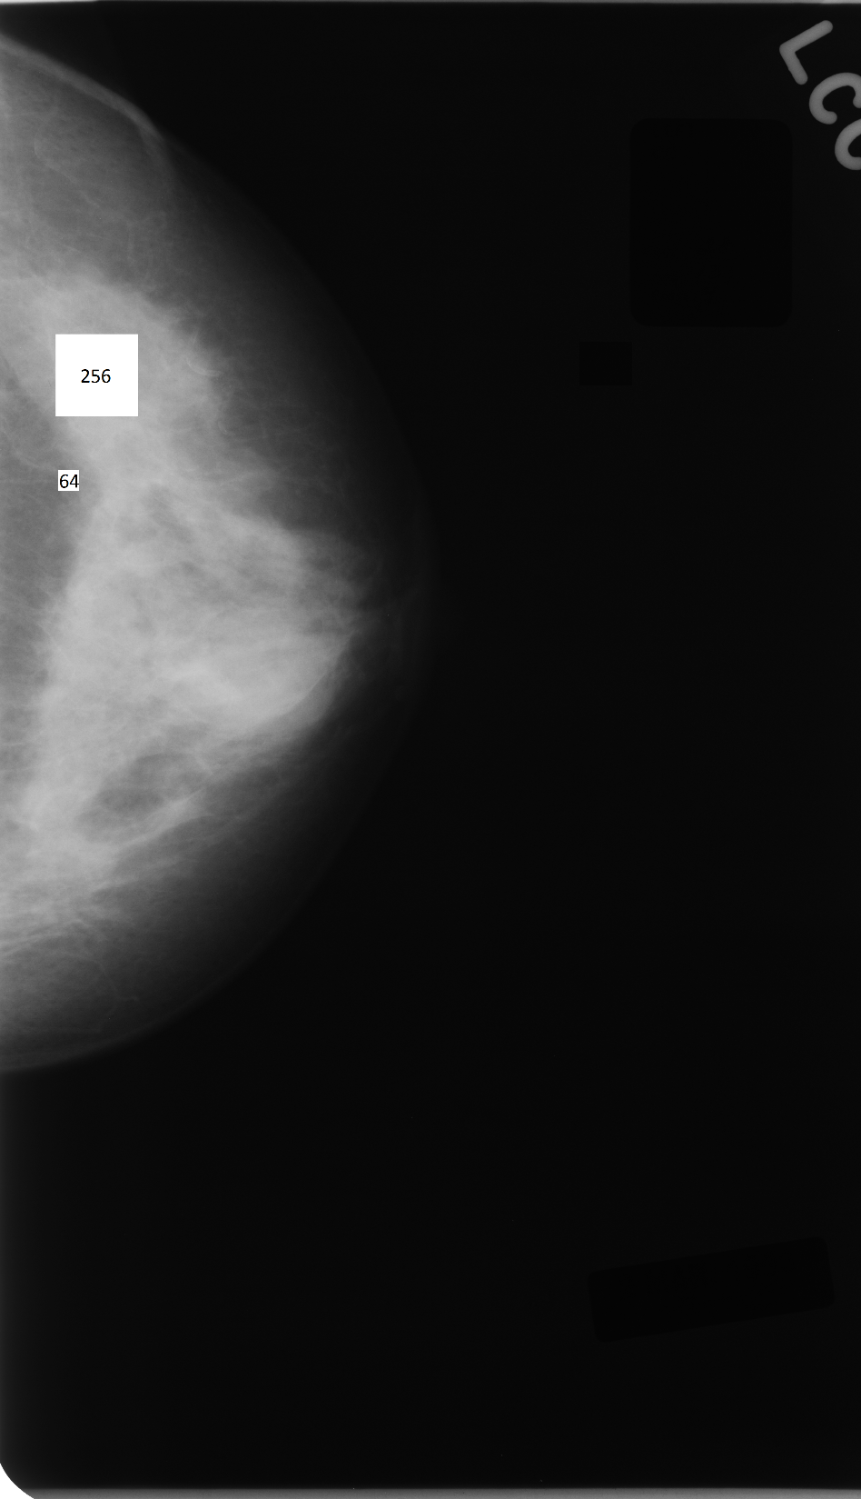
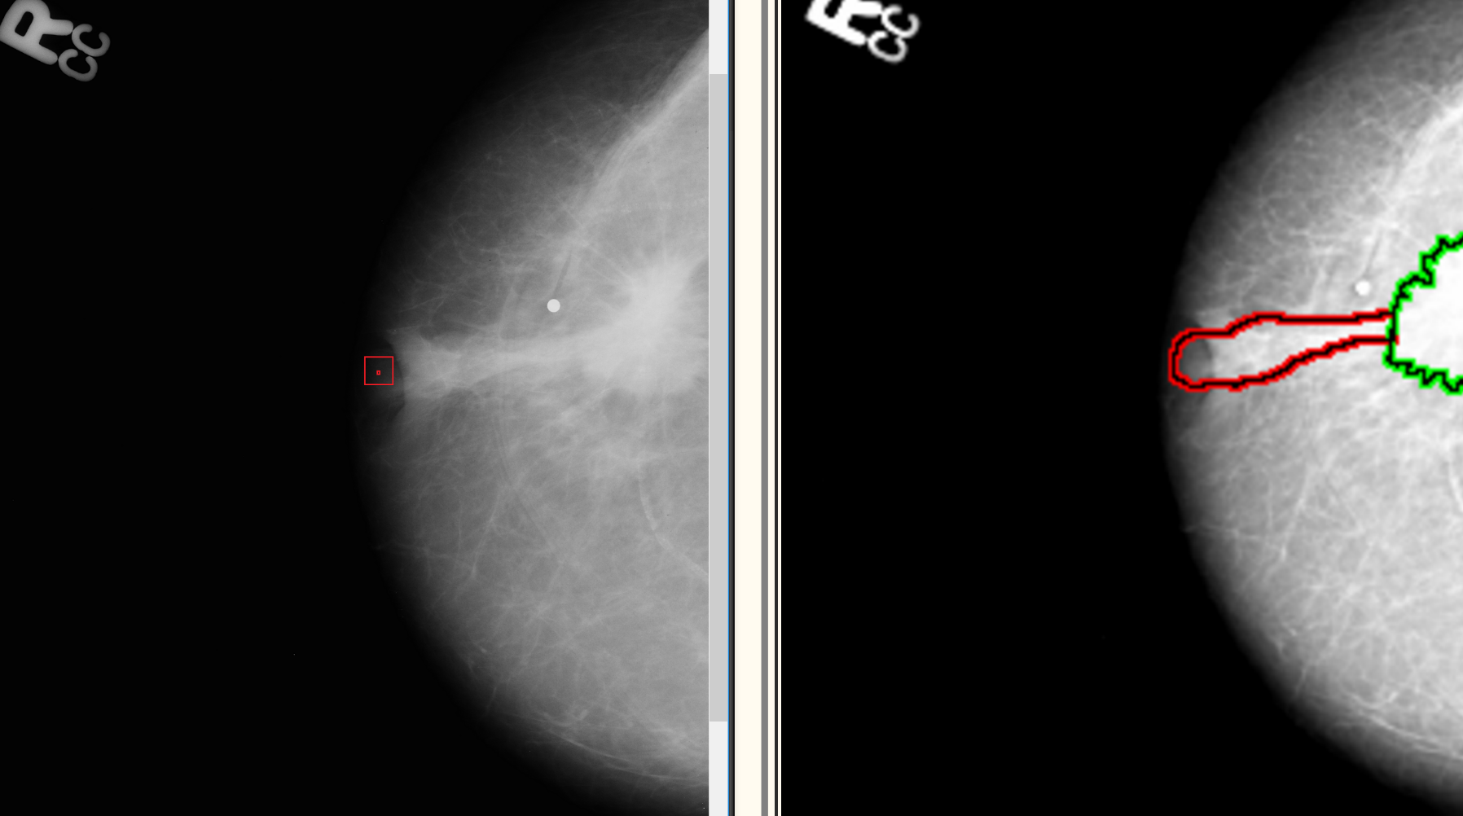
Relative sizes, subpatches
256px
64px
annotated
boundaries
100px
Notes:
This is for training on patches of the mass (so as to avoid resizing and thereby, preserving real-life aspect ratio). It would also in theory help with mass detection, since we can raster over the whole image and group regions of high probability.
However, initial experimentation with this dataset did not yield high accuracy results; but that may be because of buggy code from early experiments.
We switched to entire lesions, because it seems like a more high-level (human relatable) problem, and because it is known from previou studies to have worked well.

Slide 7
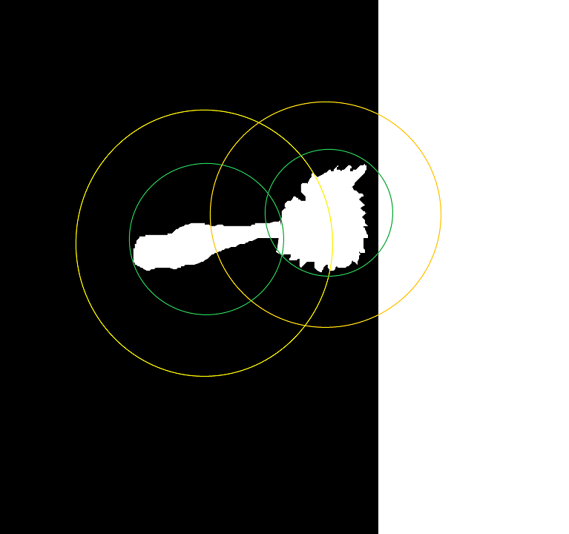

Find region of interest
100px
annotated
boundaries
4000 x 2500 img

Slide 8

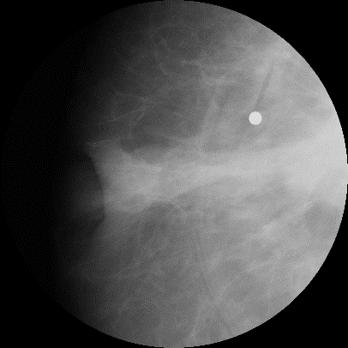
Crop region of interest, +50% margin
cancer_01-B_3013_1.RIGHT_CC-malign-B5-D2-A77-S5-a0-y1815-x1803-r0412
-L_MASS-T_IRREGULAR_ARCHITECTURAL_DISTORTION-E_SPICULATED.png

Slide 9
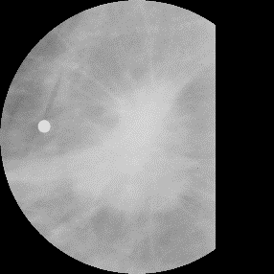
Crop region of interest, +50% margin
cancer_01-B_3013_1.RIGHT_CC-malign-B5-D2-A77-S5-a1-y1656-x2436-r0338
-L_MASS-T_IRREGULAR_ARCHITECTURAL_DISTORTION-E_SPICULATED.png

Slide 10
Samples
 | Benign | Malignant | Both | Total
Patients | 515 | 581 | 21 | 1117
Split by patients:
80% train
20% validation
Masses | Benign | Malignant | Total
Train | 903 | 978 | 1881
Validation | 238 | 243 | 481
Pros:
fairly evenly distributed
Cons:
not a very big dataset!!
Notes:
# 21 cases_shared.txt # 515 uniq_benign.txt # 581 uniq_malignant.txt # 1117 total

Slide 11
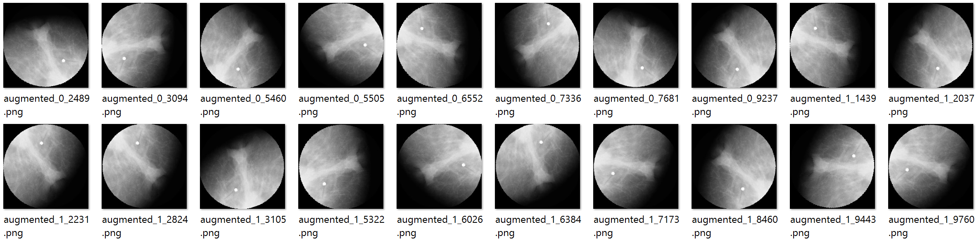

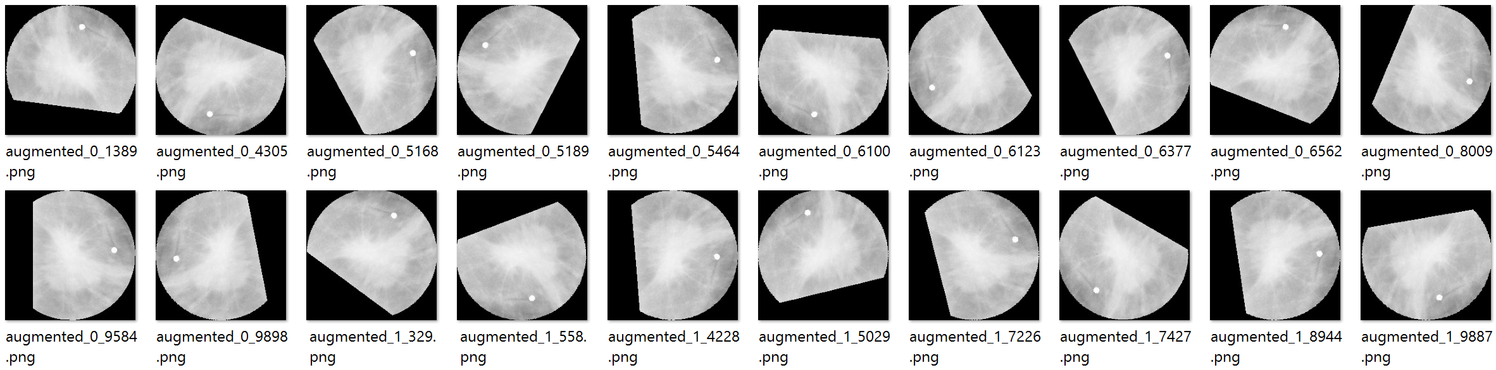
Augmented data: random rotate/flip

Slide 12
Shallow: 3-CN architecture
_________________________________________________________________________________
Layer Modification Activation Output Shape Param #
=================================================================================
input zeropad (None, 98, 98, 1) 0
_________________________________________________________________________________
convolution2d 3x3, 1 relu (None, 96, 96, 32) 320
_________________________________________________________________________________
maxpooling2d zeropad (None, 48, 48, 32) 0
_________________________________________________________________________________
convolution2d 3x3, 1 relu (None, 48, 48, 64) 18,496
_________________________________________________________________________________
maxpooling2d zeropad (None, 24, 24, 64) 0
_________________________________________________________________________________
convolution2d 3x3, 1 relu (None, 24, 24, 128) 73,856
_________________________________________________________________________________
maxpooling2d (None, 12, 12, 128) 0
_________________________________________________________________________________
flatten (None, 18432) 0
_________________________________________________________________________________
dense(64) relu (None, 64) 1,179,712
_________________________________________________________________________________
dropout(0.5) (None, 64) 0
_________________________________________________________________________________
dense(1) softmax (None, 1) 65
=================================================================================
Total params: 1,272,449
Optimizer: RMSprop
Loss: binary crossentropy

Slide 13
Shallow: 3-CN training from scratch
Notes:
final
Validation Accuracy Shallow: 0.734375
Validation Accuracy Deep: 0.828125

Slide 14
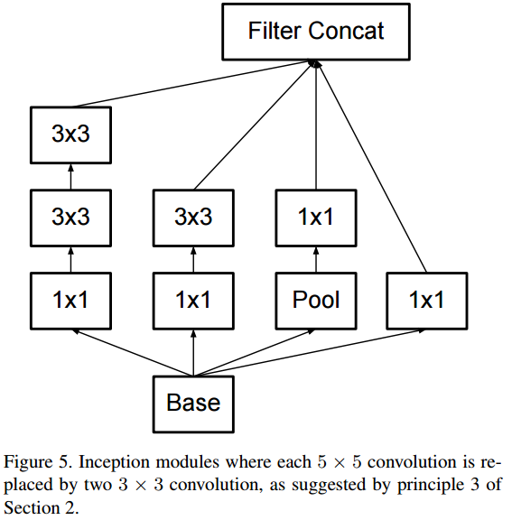
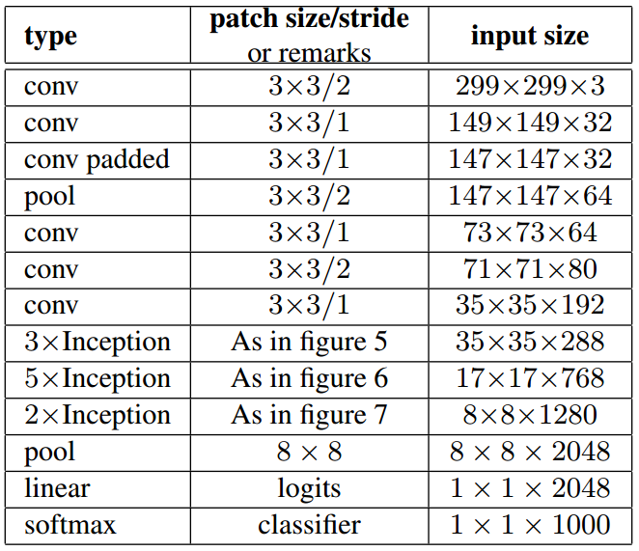
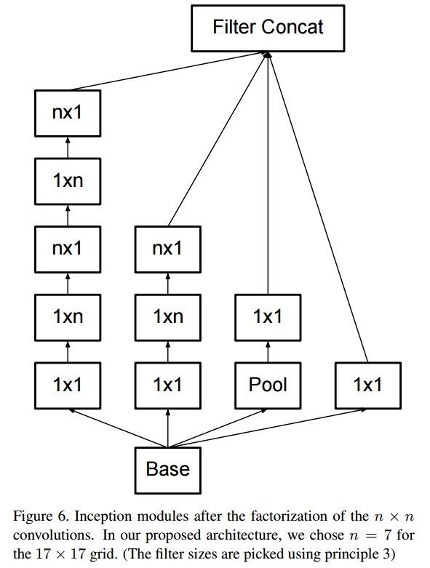
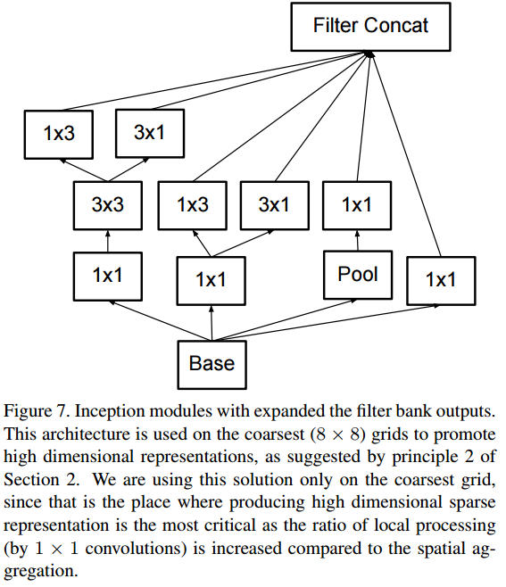
Deep: InceptionV3 architecture
changed to '2'
https://arxiv.org/pdf/1512.00567v3.pdf

Slide 15
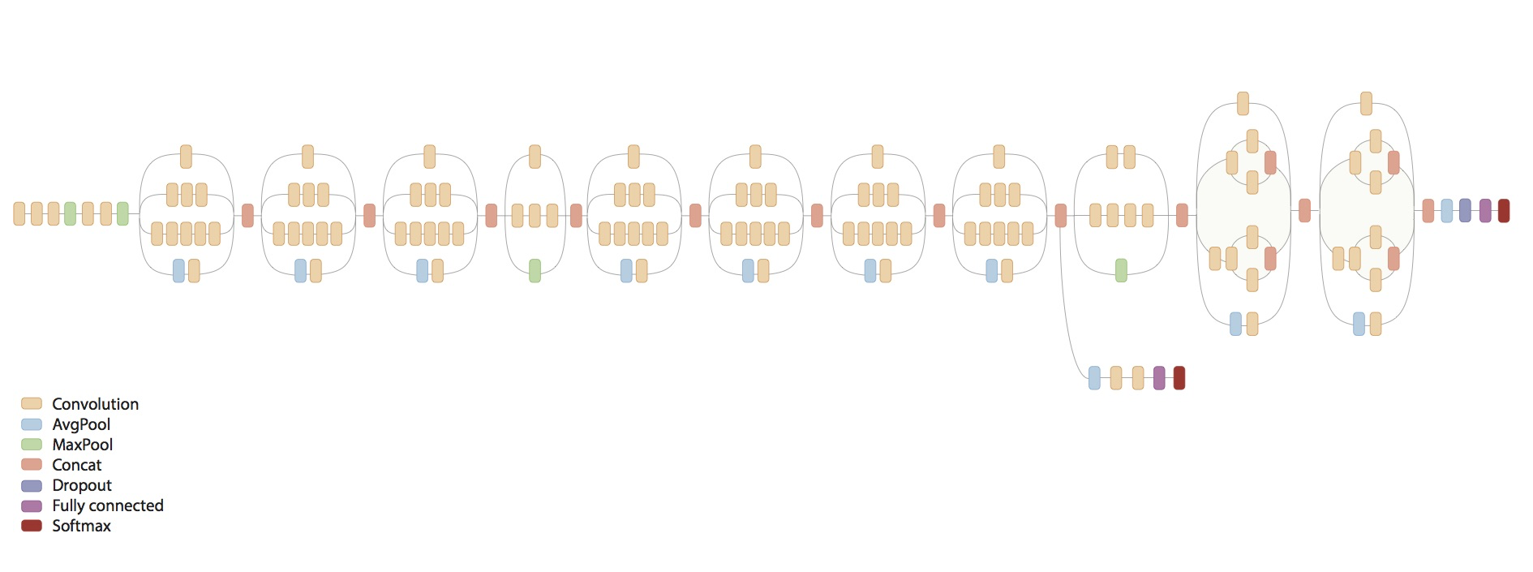
InceptionV3 schematic
https://github.com/tensorflow/models/tree/master/slim/nets
https://github.com/tensorflow/models/tree/master/inception

Slide 16
Deep: InceptionV3 finetuning from Imagenet
Notes:
accidentally overwrote my weights file in between epochs (most of that was spent finetuning only the last classification layer)
final
Validation Accuracy Shallow: 0.734375
Validation Accuracy Deep: 0.828125

Slide 17
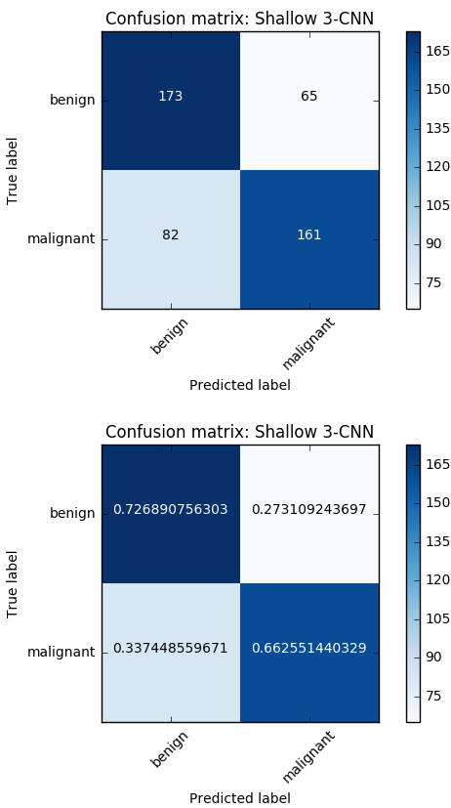
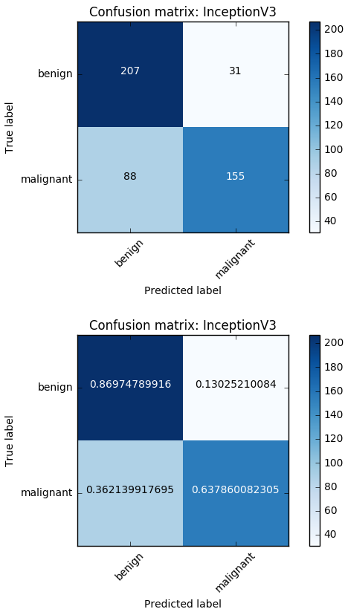
Shallow
final val_acc:
0.734375
InceptionV3
final val_acc:
0.828125
Notes:
Both models confuse some malignant masses as benign
The deeper model is better at predicting benigns correctly.

Slide 18
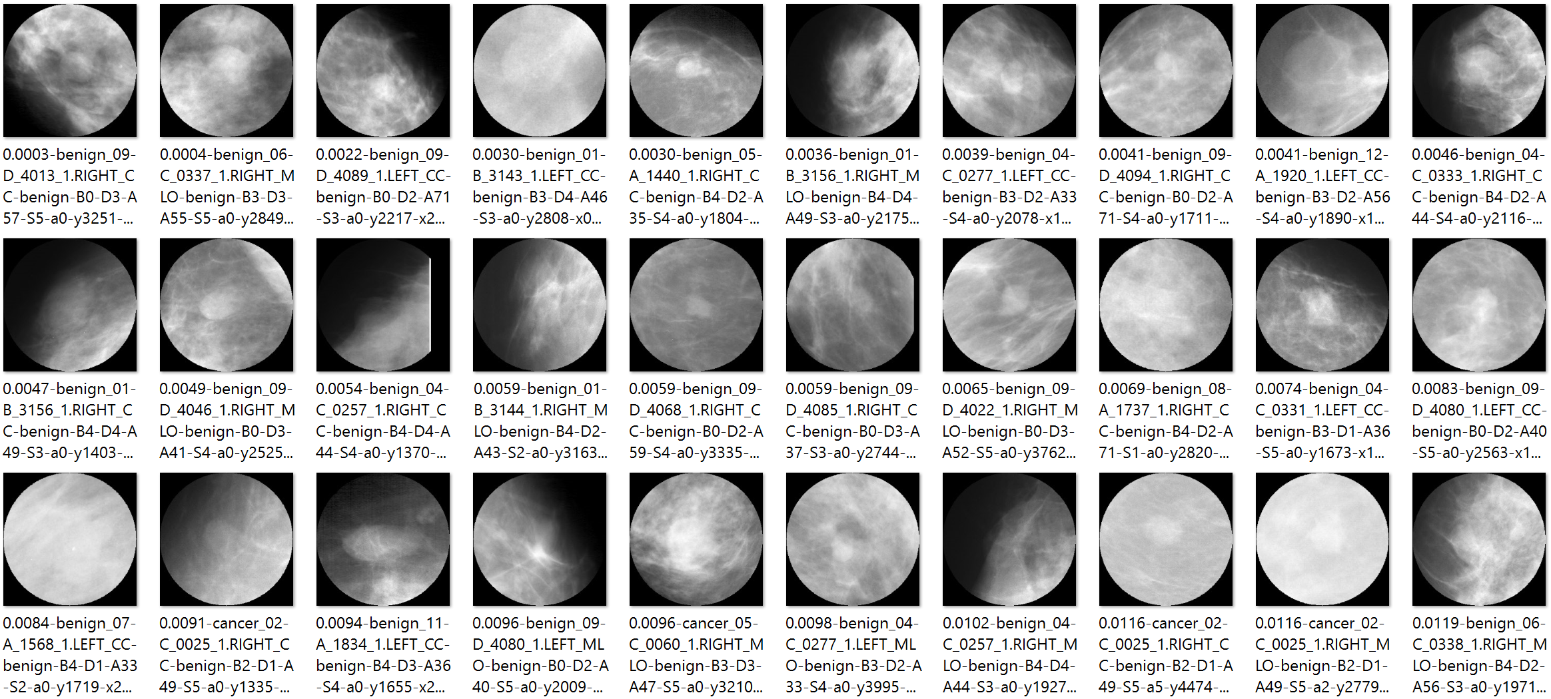
True negatives: top 30 (benign predicted as benign)
Notes:
usually no well formed mass, and often with a lot of black or a lot of white

Slide 19
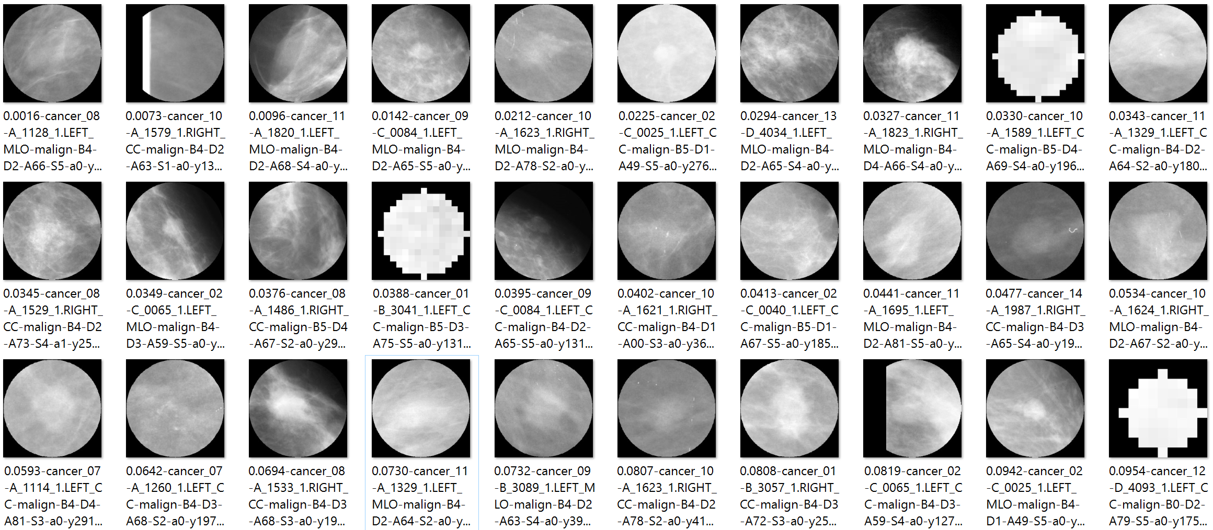
False negatives: top 30 (cancer predicted as benign)
Notes:
masses are not very well formed, and some are artefactual (all white), likely due to a small boundary/mask region that was interpolated/upsized

Slide 20
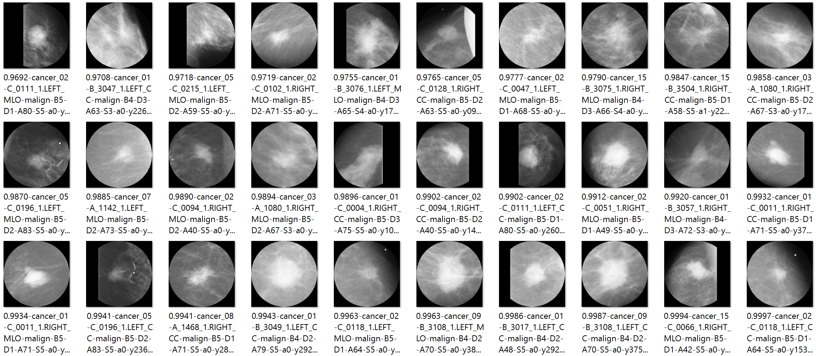
True positives: top 30 (cancer predicted as cancer)
Notes:
Very well formed masses, often with spiculations

Slide 21
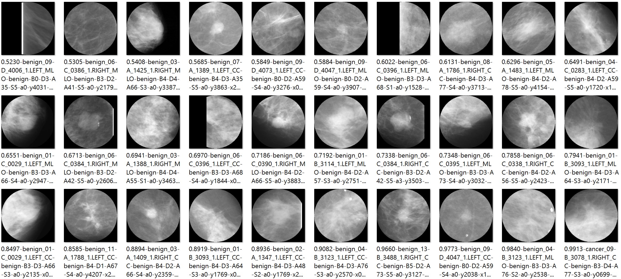
False positives: top 30 (benign predicted as cancer)
Notes:
Tend to look like masses

Slide 22
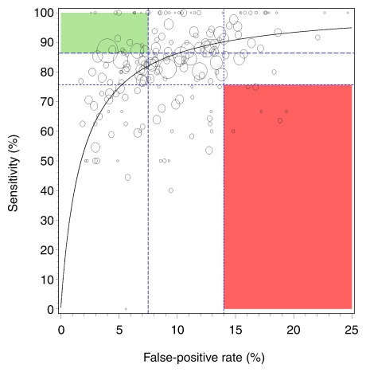
Human Performance: 187 U.S. radiologists
green = top quartile human
red = bot quartile human
shallow 3-CN
InceptionV3
Googlenet (prev. study)
http://pubs.rsna.org/doi/10.1148/radiol.2533082308
Notes:
Validation Accuracy Shallow: 0.734375
Validation Accuracy Deep: 0.828125
shallow:
Bpred, Mpred
Btrue[173, 65],
Mtrue [ 82, 161]
FPR = 65/(173+65) = 0.27310924369
Sen = 161/(82+161) = 0.66255144032
deep:
[207, 31]
[ 88, 155]
FPR = 31/(207+31) = 0.13025210084
Sen = 155/(88+155) = 0.6378600823
deepmammo:
precision = 0.924
Sen/recall = 0.934

Slide 23
Concluding thoughts
Performance is encouraging
on par with lower quartile of human radiologists
Difficulty of the problem could benefit from:
more data!
$ 1.2 Million, Digital Mammography DREAM Challenge
86,000 patients -> 640,000 images
cleaner data (remove artifacts)
integrating image views (MLO vs CC) of the same lesion
semantic analysis of features
varying model architecture and hyper-parameters

Slide 24
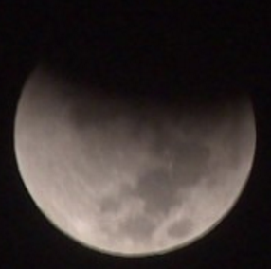
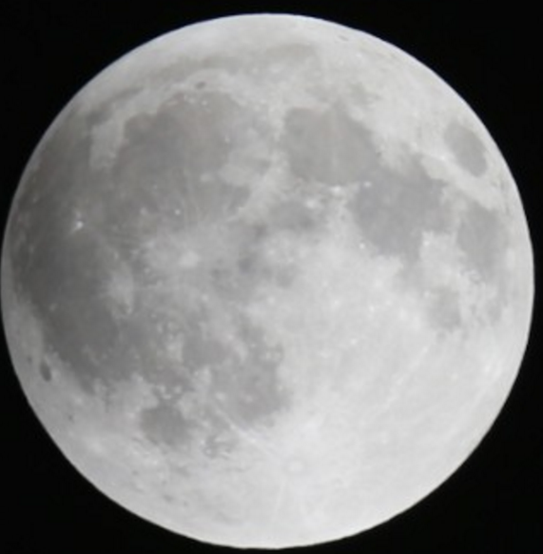
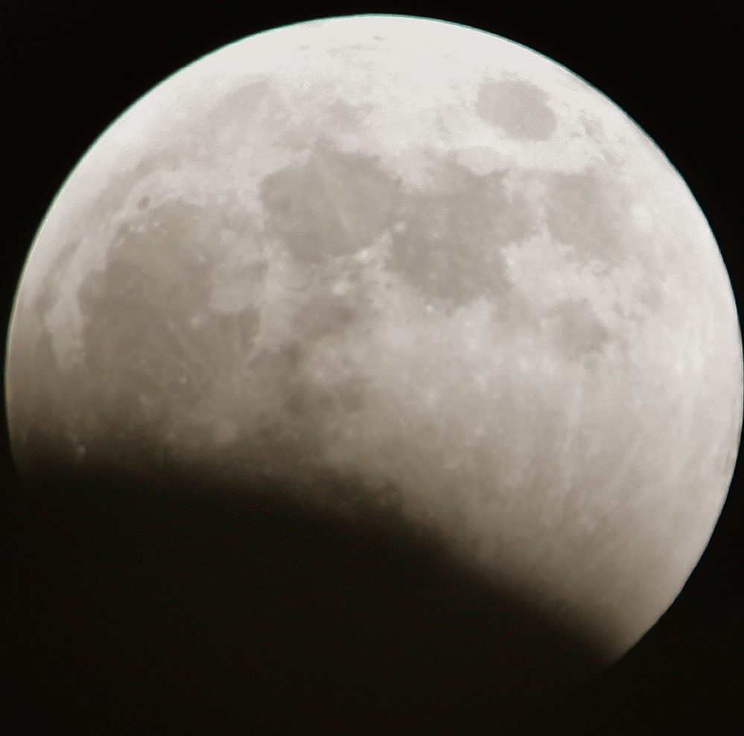
Questions?
Thank you!
moon moon moon
malignant malignant malignant

